Slide 1
Measures of central tendency and variation
Mean, median, mode, range, variance, standard deviation

Slide 2
Measures of central tendency. 1) The mean for a sample versus the mean for a population
Mean – Most commonly used measure of central tendency
Average of all observations
The sum of all the scores divided by the number of scores
Sample mean:
Population mean:

Slide 3
Example
A sample of 10 trees randomly selected from a forest showed the following dimensions:
Diameter (inches):
9.8, 10.2, 10.1, 14.5, 17.5, 13.9, 20.0, 15.5, 7.8, 24.5
Find the mean for the sample:
inches
Note: The mean has the same units as the data in the sample or population.

Slide 4
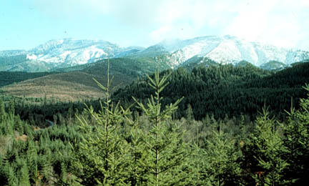
Mean – a sensitive measure
Advantage
Includes all values in estimating the mean
Disadvantage
Very sensitive to outliers… What is an outlier?
No. | Tree Height (m) |  | No. | Tree Height (m)
1 | 5.0 |  | 6 | 5.3
2 | 6.0 |  | 7 | 7.1
3 | 7.5 |  | 8 | 25.4
4 | 8.0 |  | 9 | 7.5
5 | 4.8 |  | 10 | 4.5
Source: http://www.forestlearn.org/forests/refor.htm
Mean = 6.19 m Mean = 8.10 m

Slide 5
2) The median
Median – This is the value of a variable such that half of the observations are above and half are below this value; this value divides the distribution into two groups of equal size.
When the number of observations is odd, the median is simply equal to the middle value.
When the number of observations is even, we take the median to be the average of the two values in the middle of the distribution.

Slide 6
To determine the median, values must be ordered in ascending order first
Example I
Data: 8, 4, 2, 6, 10 (mean: 6)
2, 4, 6, 8, 10
median: 6
Example II
Sample: 10 trees randomly selected from a forest
Diameter (inches):
9.8, 10.2, 10.1, 14.5, 17.5, 13.9, 20.0, 15.5, 7.8, 24.5 (mean: 14.38 inches)
7.8, 9.8, 10.1, 10.2, 13.9, 14.5, 15.5, 17.5, 20.0, 24.5
median: (13.9 + 14.5) / 2 = 14.2 inches

Slide 7
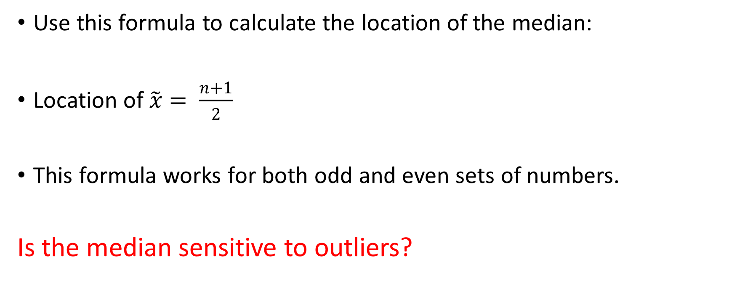
Formula for the location of the median
Use this formula to calculate the location of the median:
Location of $\tilde{x}= \frac{n+1}{2}$
This formula works for both odd and even sets of numbers.
Is the median sensitive to outliers?

Slide 8
Finding the median from a stem and leaf plot
Given the following stem and leaf plot, find the median:
5 | 6 | 8 | 9 | 9
6 | 1 | 3 | 4
6 | 5 | 7
7
7
8
8 | 6

Slide 9
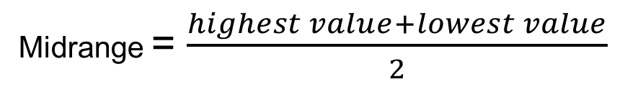
3)Midrange 4) Mode
3) The midrange is the value midway between the highest and the lowest values in the data set.
It is found by calculating the average between the highest and the lowest values.
Is the midrange sensitive to outliers?
4) Mode is the most frequently occurring value. Data can have one mode, multiple modes, or no mode.
Midrange = $\frac{highest value+lowest value}{2}$

Slide 10
Mean = 6.19 m (without outlier)
Mean = 8.10 m
Source: http://www.forestlearn.org/forests/refor.htm
median: (6.0 + 7.1) = 6.55 m
# | Tree Height (m) |  | # | Tree Height (m)
1 | 4.5 |  | 6 | 7.1
2 | 4.8 |  | 7 | 7.5
3 | 5.0 |  | 8 | 7.5
4 | 5.3 |  | 9 | 8.0
5 | 6.0 |  | 10 | 25.4
The mode is : 7.5 m

Slide 11
Which one is better: mean, median, or mode?
Consider a company that has nine employees with salaries of 35,000 a year, and the manager’s salary is 150,000 a year.
If you want to describe the typical salary in the company, which statistics will you use?
I will use mode or median (35,000), because it tells what salary most people get
Source: http://www.shodor.org/interactivate/discussions/sd1.html

Slide 12
Which one is better: mean, median, or mode?
Consider a company that has nine employees with salaries of 35,000 a year, and their manager’s salary is 150,000 a year
What if you are a recruiting officer for the company that wants to make a good impression on a prospective employee?
The mean is (35,000*9 + 150,000)/10 = 46,500 I would probably say: "The average salary in our company is 46,500" using mean
Source: http://www.shodor.org/interactivate/discussions/sd1.html

Slide 13
Practice
1. The following data has been collected showing the amount of time (in minutes) students travel from residence to the campus per day:
12 10 23 24 15 16 10 7
Find:
A) The mean
B) The median
C) The mode
D) The midrange

Slide 15
Order the data: 7 10 10 12 15 16 23 24 Mean: 14.625 Median: 13.5 Midrange: 15.5 Mode: 10

Slide 16
Measures of variation or dispersion. Sometimes measures of central tendency are not able to describe a set of data accurately enough, due to the different range of spread of the values for that particular data.
Q 1) For the 2 sets of data below, what are the values of mean and median?
Q 2) Are the 2 sets identical or similar?
Mean: 1st set: 2nd set:
Median: 1st set: 2nd set:
Single line | 6.5 | 7.0 | 8.2 | 9.2 | 5.8
Individual lines | 6.8 | 6.9 | 7.0 | 7.8 | 8.2

Slide 18

The range
The range R for a collection of data values is the difference between the highest (H) and the lowest (L) data values.
$R=H−L$

Slide 19
Calculate the range for the following 2 sets of data, then draw a dot plot for each set. What do you notice?
Set 1: The list of the number of books History students read for research purposes is shown below:
6, 11, 5, 1, 6, 6, 7, 5, 7, 6.
Set 2: The list of the books that Sociology students read for research purposes is shown below:
10, 3, 9, 2, 2, 11, 2, 1, 9, 11.

Slide 20
Set I: 6, 11, 5, 1, 6, 6, 7, 5, 7, 6. Set II:10, 3, 9, 2, 2, 11, 2, 1, 9, 11

Slide 22
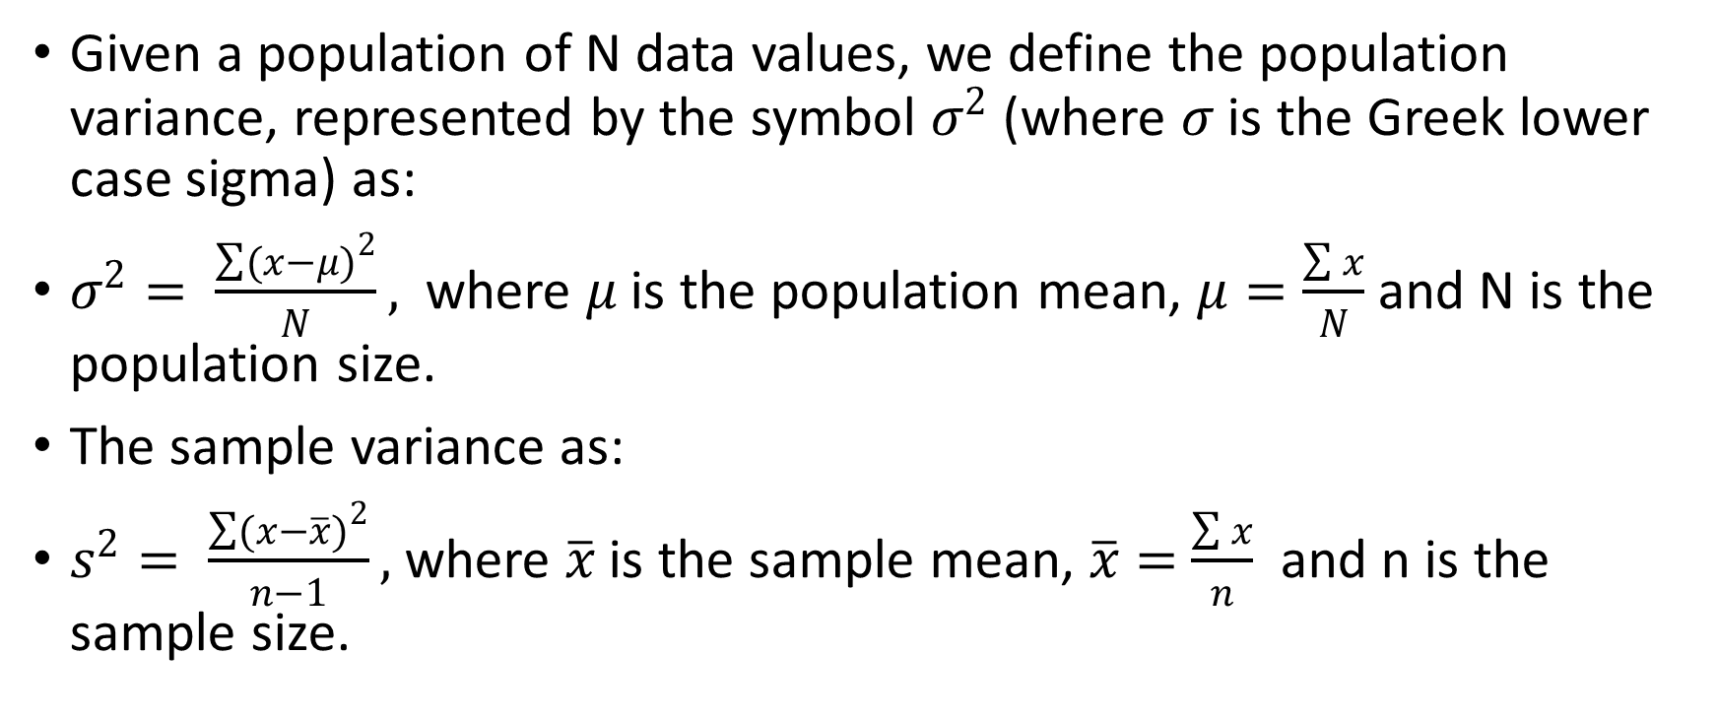
Population and sample variance
Given a population of N data values, we define the population variance, represented by the symbol $σ^{2}$ (where $σ$ is the Greek lower case sigma) as:
$σ^{2}= \frac{\sum{{(x−μ)}^{2}}}{N},$where $μ$ is the population mean, $μ=\frac{\sum{x}}{N}$ and N is the population size.
The sample variance as:
$s^{2}= \frac{\sum{{(x−\overline{x})}^{2}}}{n−1},$where $\overline{x}$ is the sample mean, $\overline{x}=$ $\frac{\sum{x}}{n}$ and n is the sample size.

Slide 23
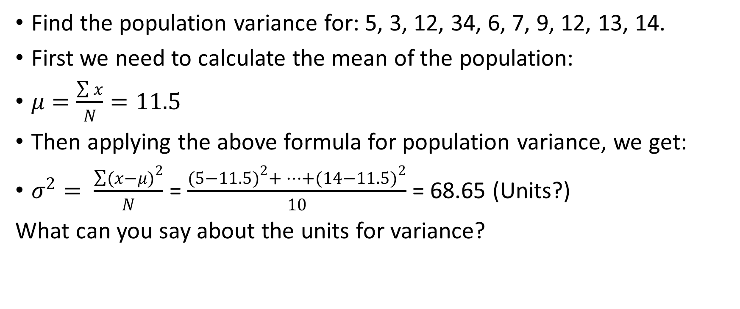
Example
Find the population variance for: 5, 3, 12, 34, 6, 7, 9, 12, 13, 14.
First we need to calculate the mean of the population:
$μ=\frac{\sum{x}}{N}=11.5$
Then applying the above formula for population variance, we get:
$σ^{2}= \frac{\sum{{(x−μ)}^{2}}}{N}$ = $\frac{{(5−11.5)}^{2}+…+{(14−11.5)}^{2}}{10}$ = 68.65 (Units?)
What can you say about the units for variance?

Slide 24
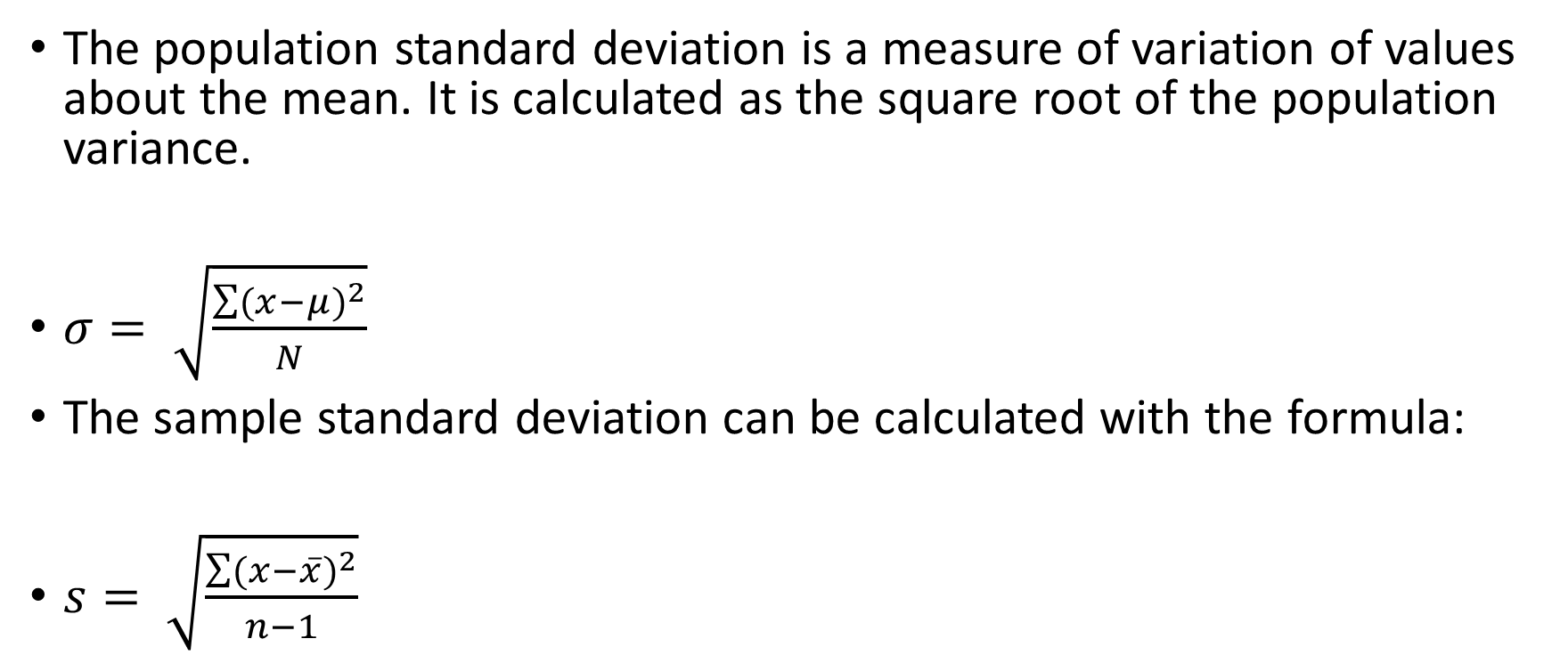
Population and sample standard deviation
The population standard deviation is a measure of variation of values about the mean. It is calculated as the square root of the population variance.
$σ= \sqrt{\frac{\sum{{(x−μ)}^{2}}}{N}}$
The sample standard deviation can be calculated with the formula:
$s= \sqrt{\frac{\sum{{(x−\overline{x})}^{2}}}{n−1}}$

Slide 25
Are measures of variation sensitive to outliers? Let’s check!
Calculate the mean, the variance, and the standard deviation for the following set of data:
8, 13, 14, 16, 61

Slide 26
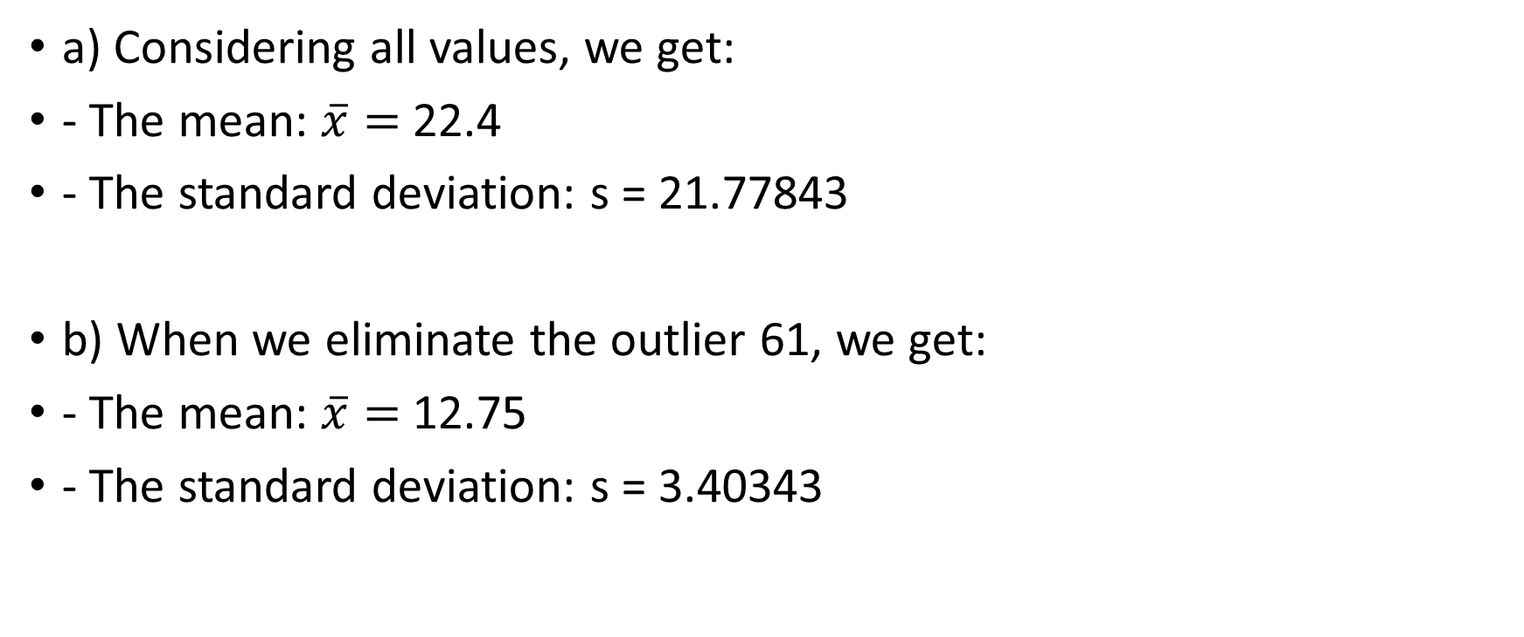
Conclusion???
a) Considering all values, we get:
- The mean: $\overline{x}=$ 22.4
- The standard deviation: s = 21.77843
b) When we eliminate the outlier 61, we get:
- The mean: $\overline{x}=$ 12.75
- The standard deviation: s = 3.40343

Slide 27
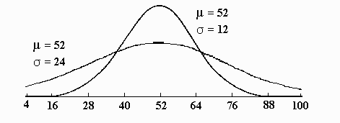
Interpreting the Concept of Dispersion
The taller curve has less dispersion.
The flatter curve has more dispersion.

Slide 28
How do we interpret standard deviation?
Standard deviation shows the extent of the spread for a data set. Values that are closer together will result in smaller standard deviations, while values that are far apart from each other will result in larger standard deviation.

Slide 29
The empirical rule
This rule applies only to bell-shaped distributions and states that:
a) About 68% of all scores fall within 1 standard deviation of the mean.
b) About 95% of all scores fall within 2 standard deviations of the mean.
c) About 99.7% of all scores fall within 3 standard deviations of the mean.

Slide 30
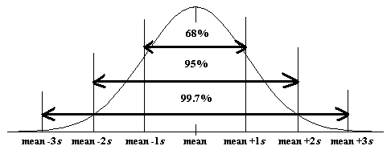
Empirical rule representation

Slide 31
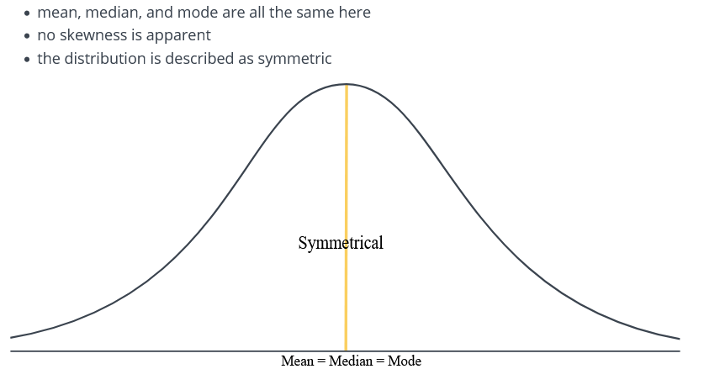
Relationship between the shape of distribution and the measures of central tendency. 1. Symmetrical or normal distribution

Slide 32
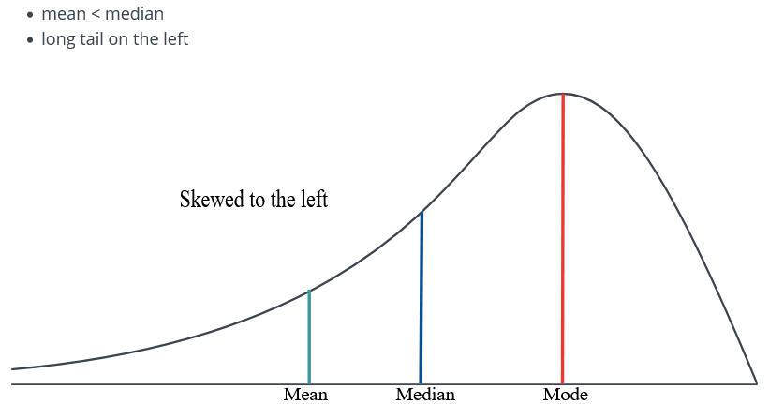
2. Skewed to the left

Slide 33
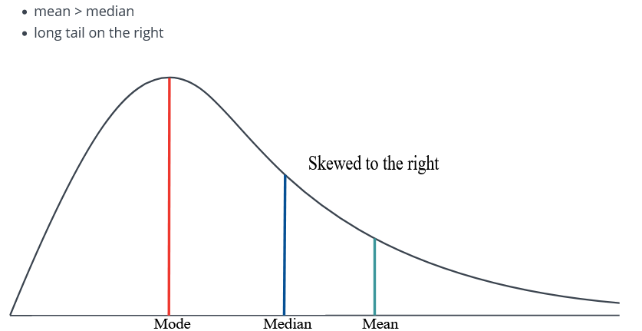
3. Skewed to the right

Slide 34
Practice
The following data has been collected showing the amount of time (in minutes) students travel from residence to the campus per day:
12 10 23 24 15 16 10 7
Find:
A) The range
B) The standard deviation

Slide 36
Answers
Variance, s^2: 38.26786
St. Dev., s: 6.186102
Range: 17

Slide 37
Practice True or False?
1. Some sets of data do not have a mean.
2. There is always a mode for each set of data.
3. The median is always a number in the data set.

Slide 38
It is possible that a distribution of scores could have more than one:
A. Mode.
B. Median.
C. Standard deviation.
D. Mean.

Slide 39
Because it uses every score in a distribution and is easy to interpret, the ___________ is the most common measure of variability.
Variance
Mean
Range
Standard deviation

Slide 40
A professor examined the Math scores of the first-year students in his statistics class to see the variability. He found the variance to be 14400. What is the standard deviation?
120
1440
2,073,600
570

